Slide 1
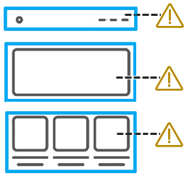

May 24, 2023
Understand
Test
Solve
SEMANTICS

Slide 2

Aaron Farber
2016: Change careers from public policy to tech. Attend App Academy.
2017-2019: Run accessibility testing/development shop focused on small businesses
2019-2020: TPGi - Accessibility Engineer
2021: TPGi - Embedded with large tech company
2022: TPGi – Accessibility Platform Consultant
Notes:
2019: Web Accessibility Specialist
2020: Certified Professional in Accessibility Core Competencies
IAAP: International Association of Accessibility Professionals

Slide 3
Agenda
Plan For Testing
Name, Role, Value
Chrome DevTools

Slide 4
Our Philosophy
Empowerment is about having evidence of the ability to do something oneself.

Slide 5
ARC Empowerment Program
Create a repeatable, well-defined accessibility testing process
using the ARC Platform’s tools and resources.

Slide 6
Understand, Test, Solve Webinar Series
Each month, TPGi holds a webinar covering one group of accessibility guidelines
30 Minute Talk – 30 Minute Q&A

Slide 7
Understand, Test, Solve Webinar Series
Keyboard Focus Completed
Color Contrast Completed
Structure Completed
Semantics You Are Here!
ARIA Upcoming – June
Responsive Design Upcoming - July
For past webinars’ slides and video recordings:
Go to tpgi.com/blog

Slide 8
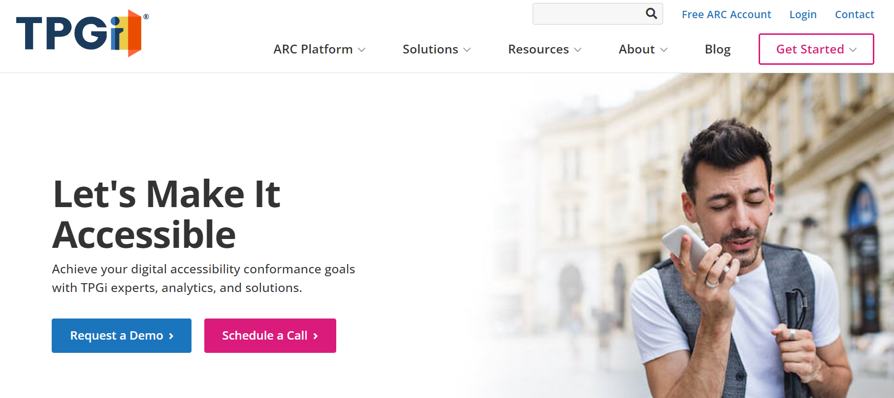
Before Monitoring, Plan for Testing

Slide 9
Break site into test samples

Slide 10
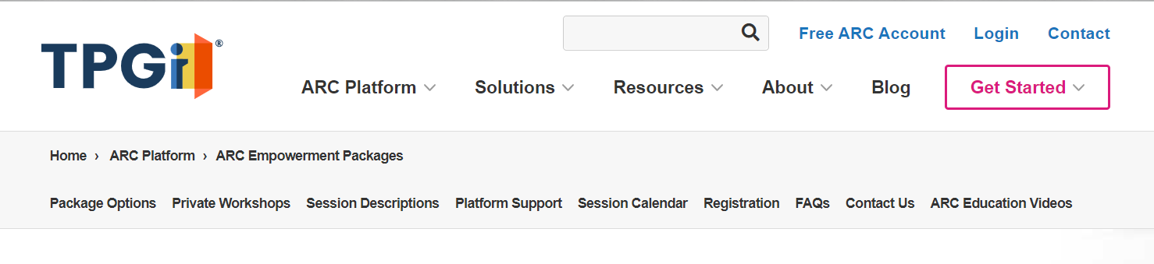
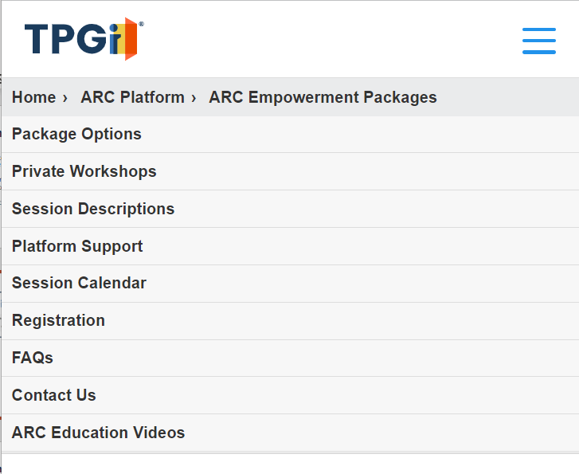
Testing includes all responsive breakpoints
Desktop layout
Mobile layout

Slide 11
How to Select a Representative Sample
Consider website structure and purpose
Include a range of content types – videos, forms, etc.
Select template components and page-specific content
Cover high-visibility, high-traffic user journeys
Each sample should be around the same size, level of effort to test

Slide 12
Why Select a Representative Sample
Not feasible to test every page
Work can be broken into manageable tasks
Easily delegate work to appropriate stakeholder, role
Facilitates communication and cross-collaboration

Slide 13
Group Related Accessibility Guidelines
Enables testing to be done by roles with the requisite skillset
Increases efficiency and reduces duplicative work - shifting between unrelated accessibility guidelines
Leads to full WCAG Coverage

Slide 14
Testing Semantics
2.5.3: Label in Name (A)
4.1.2: Name, Role, Value (A)

Slide 15
Testing Semantics
Requires
Some knowledge of HTML/CSS
Fluency with Developer Tools
Requires only basic familiarity with a screen reader

Slide 16
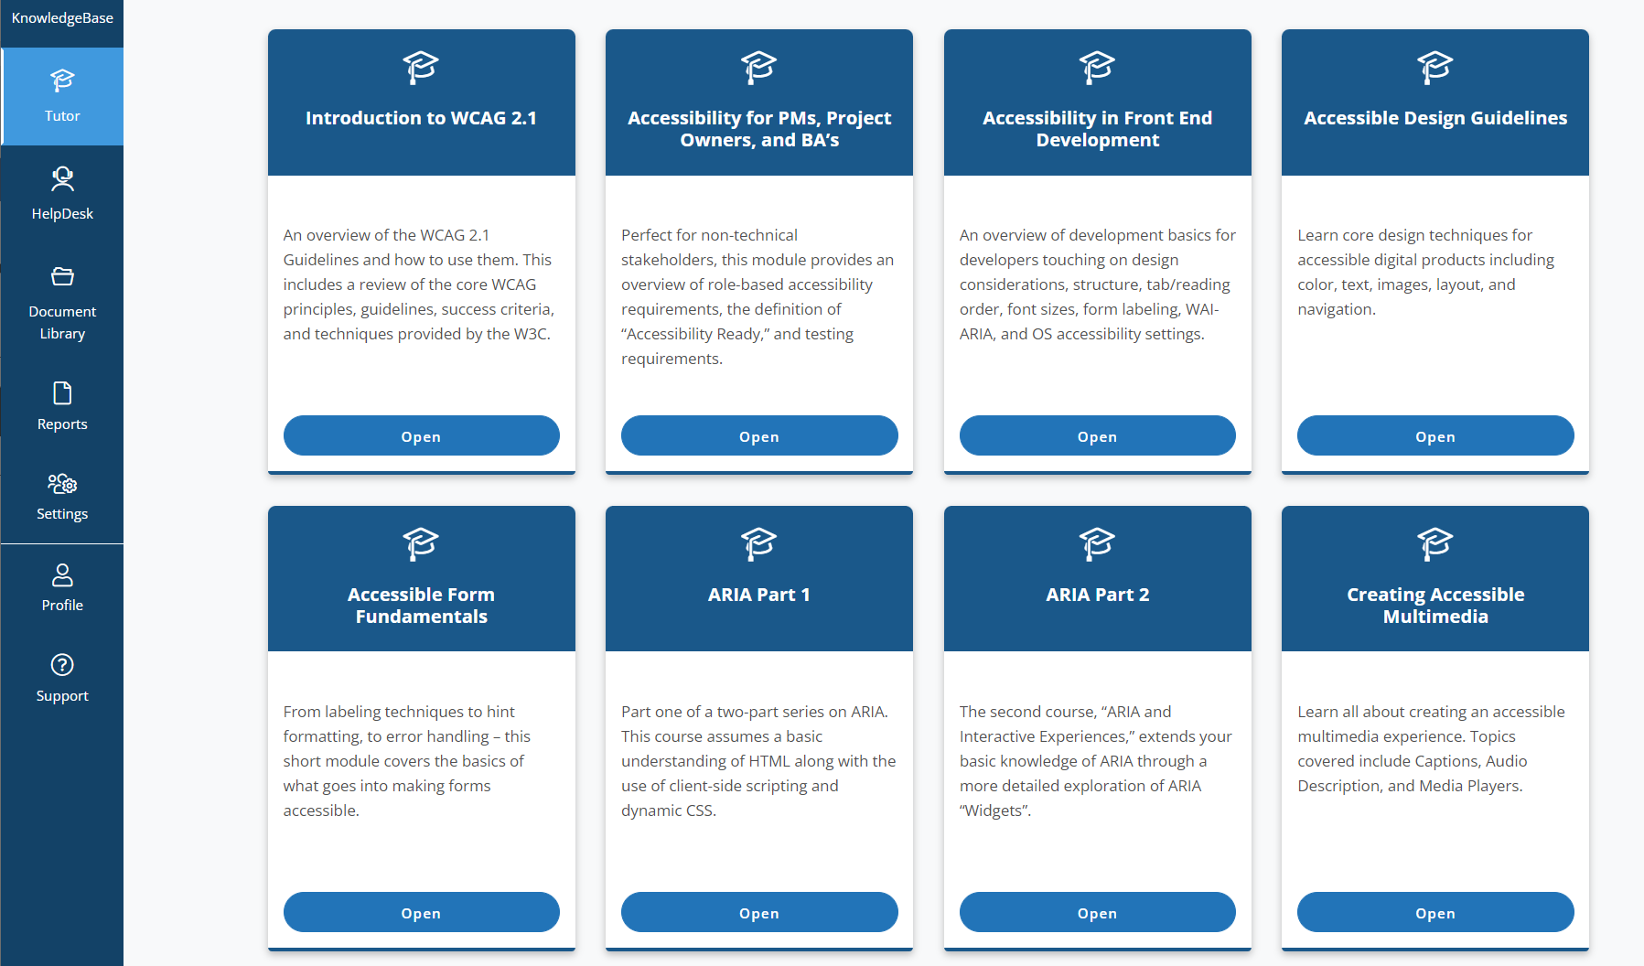
Accessibility Foundations
Consume Role-Based Trainings To Understand Fundamental Principles
For Semantics Testing: Accessibility in Front End Development is recommended

Slide 17
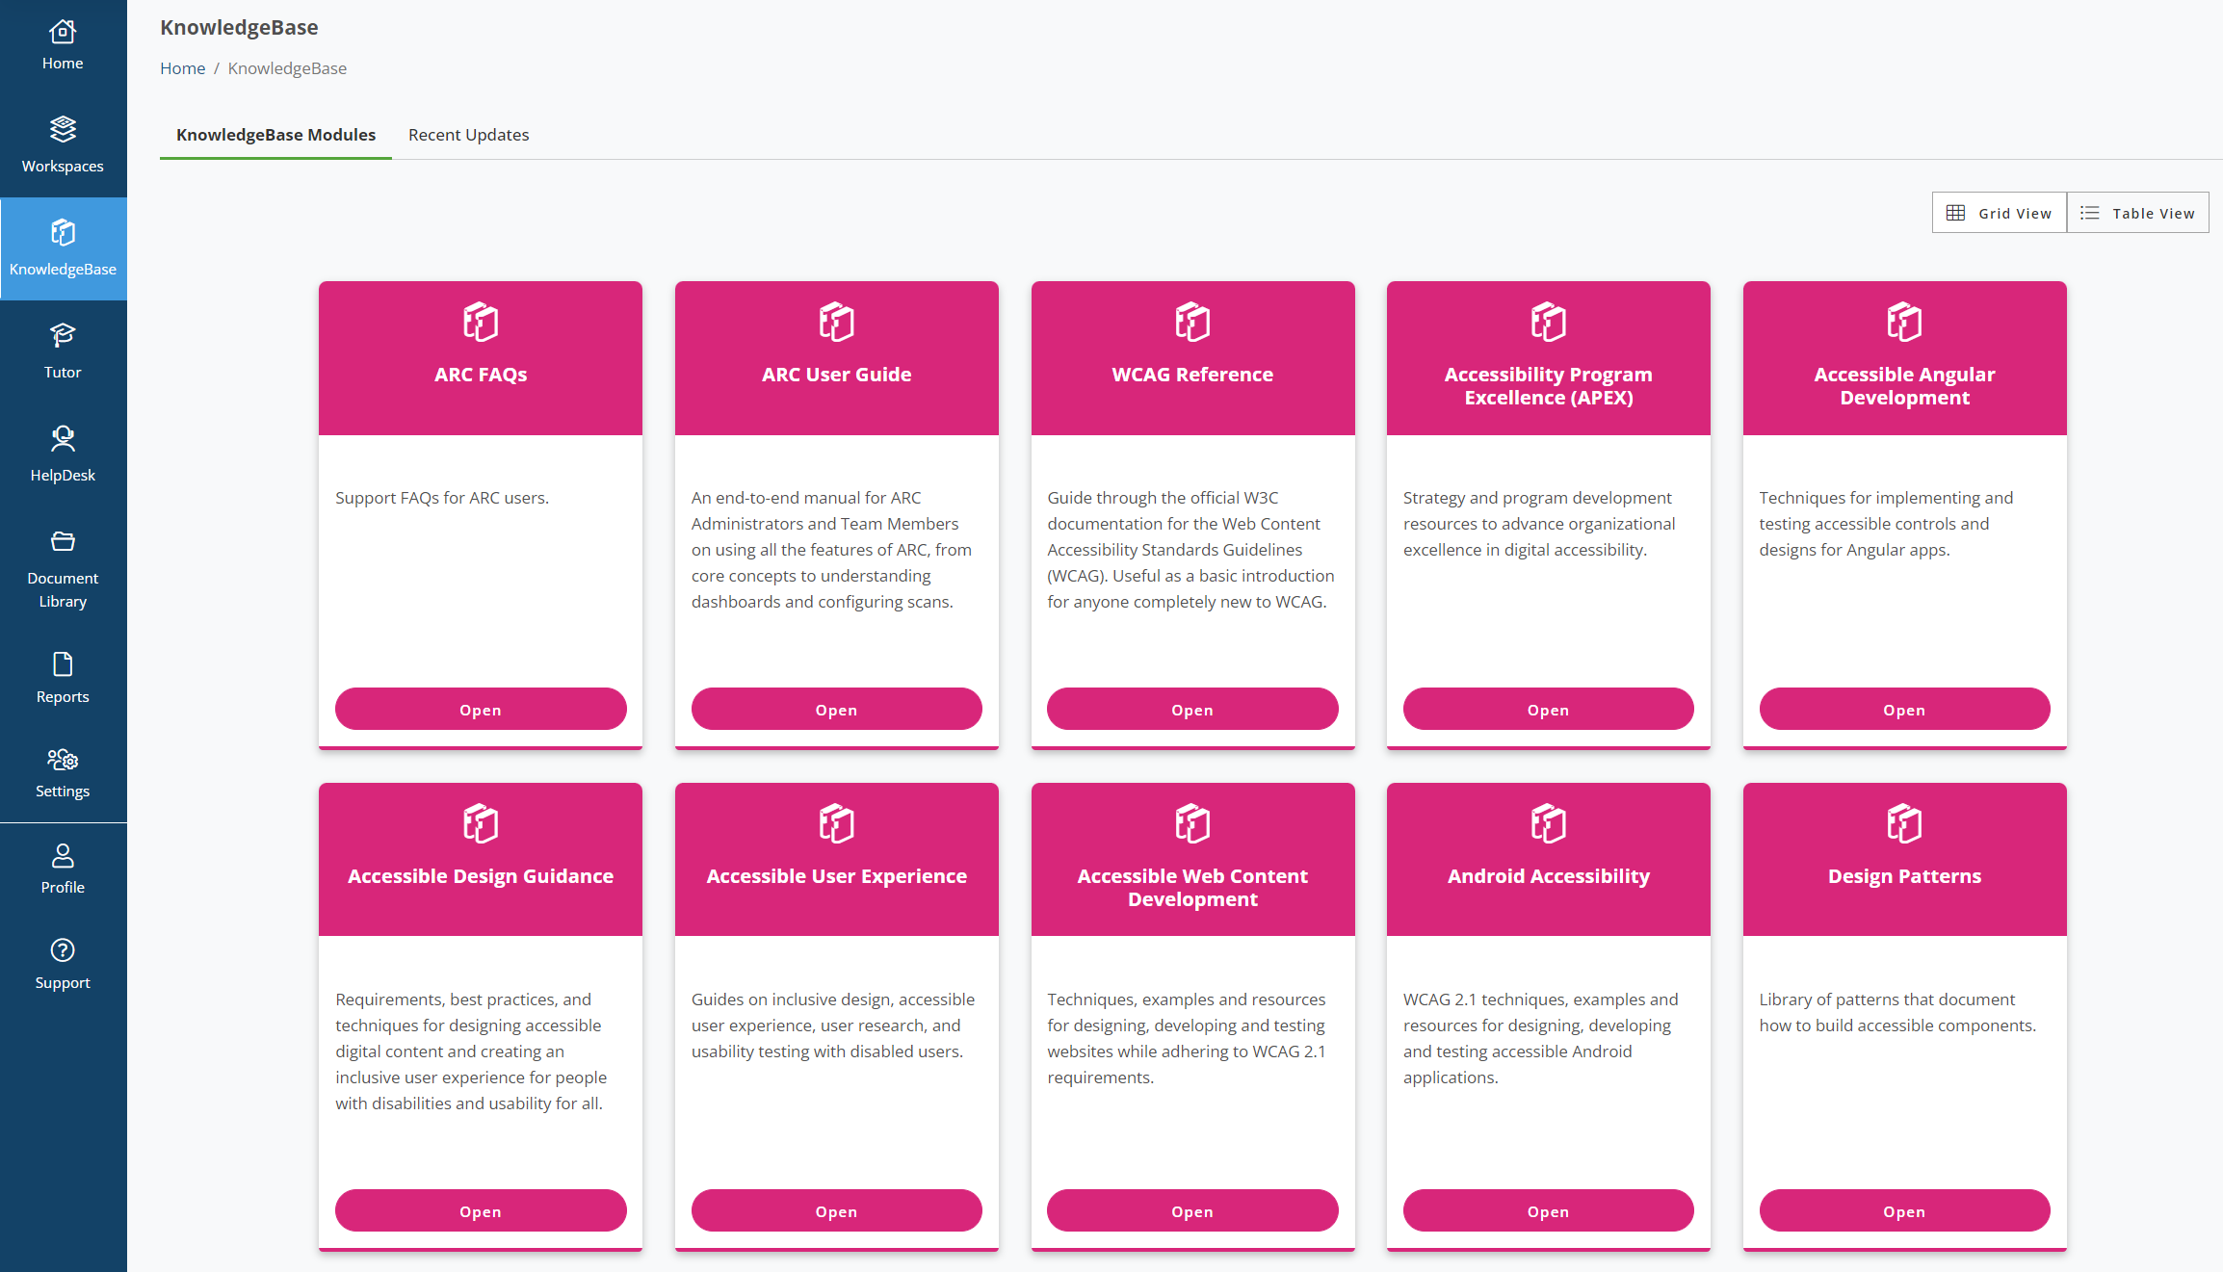
Tools and Resources
The main strength of testing with ARC is that each rule is paired with select resources from its expansive KnowledgeBase

Slide 18
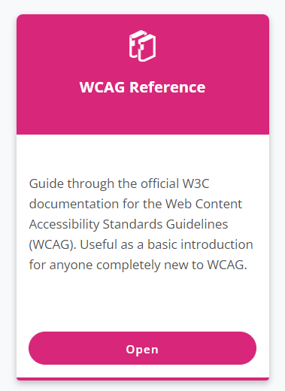
Understand
Understand The Significance of an Accessibility Guideline First
Summarizes Each WCAG Success Criteria
Including draft WCAG 2.2 Success Criteria

Slide 19
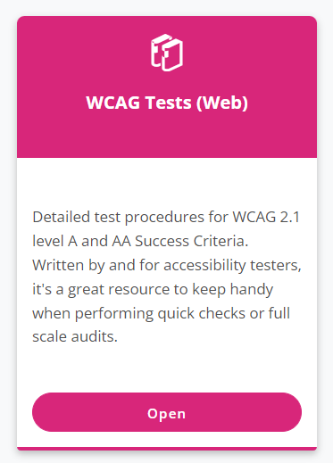
Test
Test An Issue To Determines Its Impact On User Experience
Provides Step-by-Step Manual Testing Procedure for Every Accessibility Guideline

Slide 20
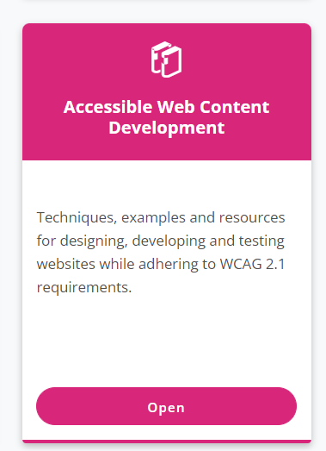
Solve
Solve an Issue with Battle-Tested, Clear Steps For Implementation
Detailed instructions with code samples, expected behaviors

Slide 21
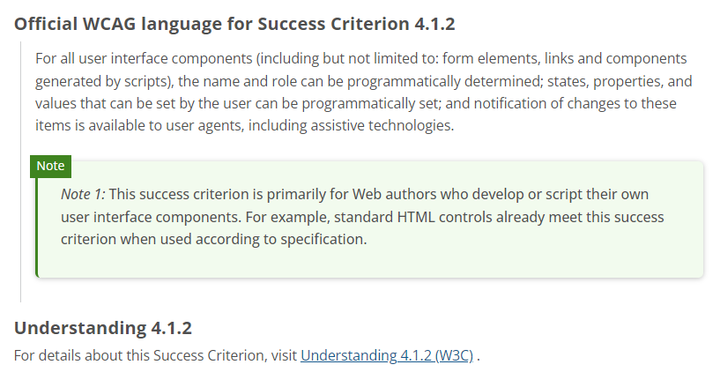
4.1.2 Name, Role, Value

Slide 22
The Browser Accessibility Tree
Roughly speaking, the accessibility tree is a subset of the DOM tree
The accessibility tree exposes elements which have meaningful semantic information.
Generally, if something (with no semantics) can be trimmed, it will be.

Slide 23
4.1.2 Name, Role, Value
Name – the label for an element
Role – the kind of user interface element
Value – the current value for an element

Slide 24
What is a name?
The accessible name is derived from different sources.
Browsers have an algorithm to compute a user interface element’s accessible name.
The accessible name for an HTML element can be derived from one of three sources:
1. element’s content
2. an attribute
3. from an associated element

Slide 25

Using the element’s content
The text content of the <a> element gives the link its accessible name

Slide 26
Using an attribute
The name is derived from the title attribute

Slide 27
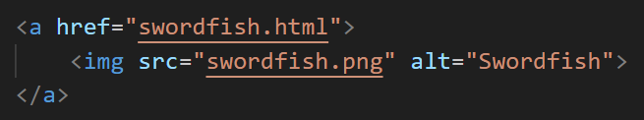
Using an attribute from a nested image
The name is derived from the nested image’s alt attribute

Slide 28
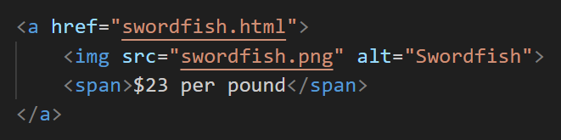
A name can be combined from multiple sources
The name is derived from the nested image’s alt attribute and text content

Slide 29

Using an associated element
The name is derived from the associated label using the for/id asssociation

Slide 30

Using ARIA – with aria-label
The name is derived from the aria-label attribute

Slide 31
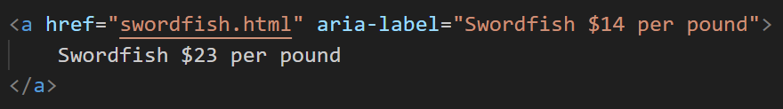
Use aria-label with caution
ARIA trumps all in computing an accessible name.
The aria-label attribute overrides the text content, or label from associated element.
Assistive technologies will announce the aria-label attribute’s value rather than the text content.

Slide 32
When the accessible name does not match the visible text
An aria-label attribute or visually hidden text may be used to provide a more descriptive accessible name.
However, the start of the accessible name and visible text should match.
If the accessible name and visible text are conflicting, that violates WCAG 2.1 Success Criteria 2.5.3 Label in Name

Slide 33
What is a role?
The kind of user interface element
Native HTML exposes the role by default
ARIA may be used to provide a role. Once again, ARIA trumps all. An ARIA role overrides native semantics.

Slide 34
One last note about roles
Links – open a new page
Buttons – trigger in-page actions
ARIA provides roles for user interface elements not defined in native HTML such as a progress bar, combobox, tab panel, etc.

Slide 35

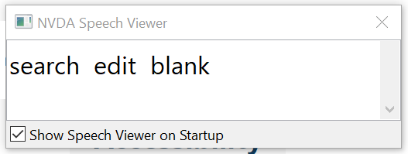
How assistive technology announces name, role, and value
Name, role, and value are announced in that order.
If an element has a description, that is announced last.

Slide 36
How to determine what browsers are exposing to the accessibility tree?
The only way to be sure how assistive technologies announce an element is to test with assistive technologies.
Now with that said, Developer Tools are a powerful resource

Slide 37
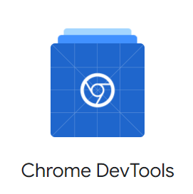
Chrome DevTools
A set of web developer tools built directly into Google Chrome browser
Inspect every aspect of a webpage from CSS to JavaScript source code to the semantic information exposed to the accessibility tree

Slide 38
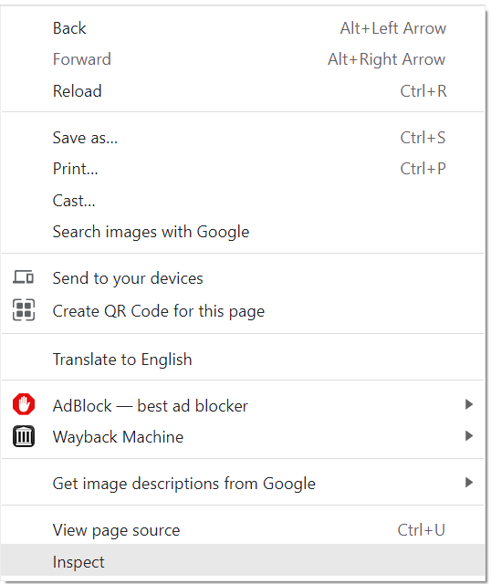
Open Chrome DevTools
OR use keyboard
OS | Elements | Console | Your last panel
Windows or Linux | Ctrl + Shift + C | Ctrl + Shift + J | F12 Ctrl + Shift + I
Mac | Cmd + Option + C | Cmd + Option + J | Fn + F12 Cmd + Option + I
Right click the page and select Inspect
PRO-TIP: Right click on the element you wish to inspect

Slide 39
Open Chrome DevTools
OR use keyboard
OS | Elements | Console | Your last panel
Windows or Linux | Ctrl + Shift + C | Ctrl + Shift + J | F12 Ctrl + Shift + I
Mac | Cmd + Option + C | Cmd + Option + J | Fn + F12 Cmd + Option + I
Right click the page and select Inspect
PRO-TIP: Right click on the element you wish to inspect

Slide 40
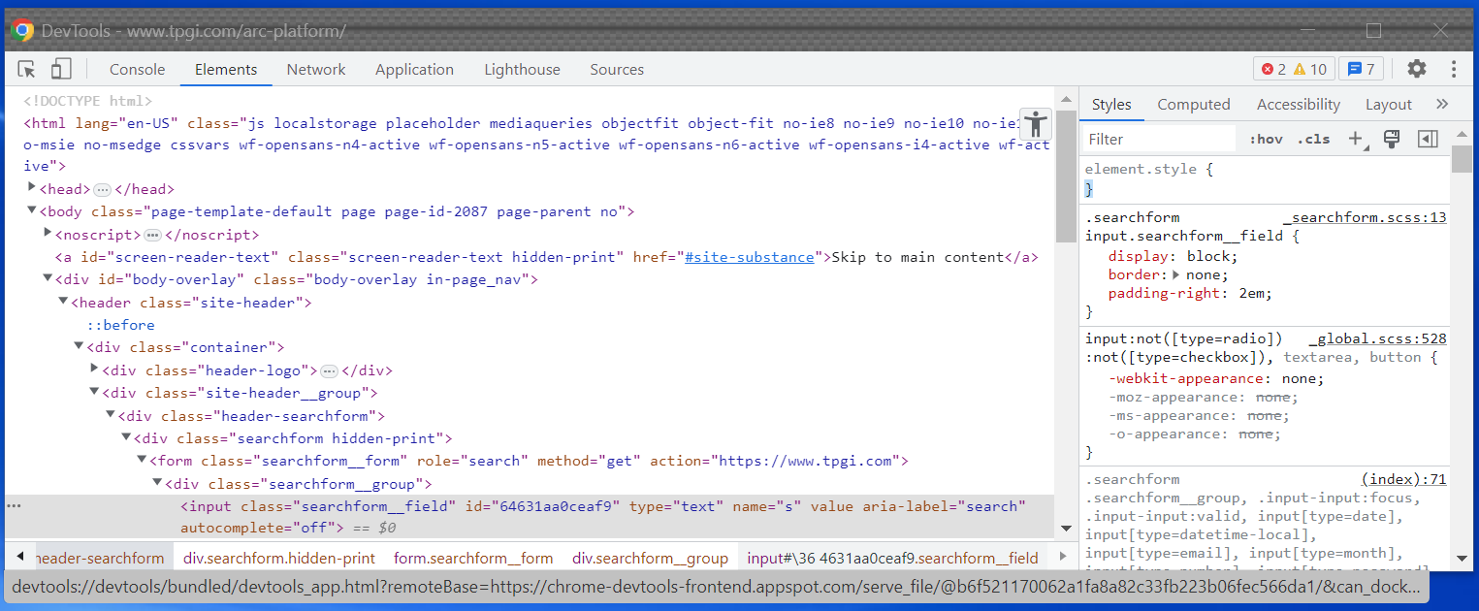
Navigating to the Accessibility Pane
If the Accessibility tab is not visible, select the >> control and select Accessibility from the dropdown menu

Slide 41
Selecting an element
In the Elements Panel, select the HTML element.
Be sure to select the element that is interacted with - and not its parent container or a descendant element

Slide 42
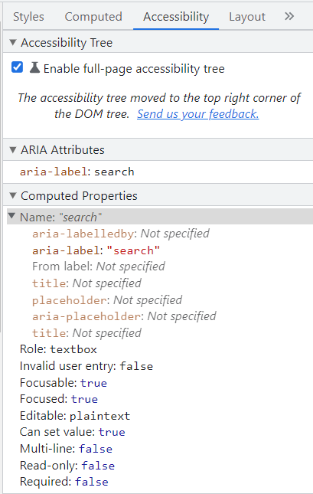
Accessibility Pane
Be sure to select the user interface element’s functional container
Chrome now offers the ability to view the entire page’s accessibility tree, not just an individual element.

Slide 43
Accessibility Pane
Name represents the accessible name derived from the set of the sources in the expanded section i.e. aria-label, aria-labelledby, From label, title, placeholder
Name: “Search” and in the expanded section, it shows the aria-label as the source of the name computation

Slide 44
Accessibility Pane
The key question is whether the element’s name, role, and value is properly conveyed to assistive technologies.
Elements not defined in native HTML will require ARIA – covered in our next webinar.

Slide 45
Accessibility Pane
Contains other important accessibility information beyond semantics.
Focusable – whether the element is included in the page’s natural tab order.
Other properties e.g. Editable, Read-only, Required, Multi-line, apply to form elements

